Slide 1
Best Streaming Services
Passang Dukpa

Slide 2

Business Problem
How can we see a rise in Netflix’s monthly subscriptions and streaming

Slide 3




Benefits
Rise in monthly subscriptions
Better movies to be streamed
Outperform other streaming platforms

Slide 4
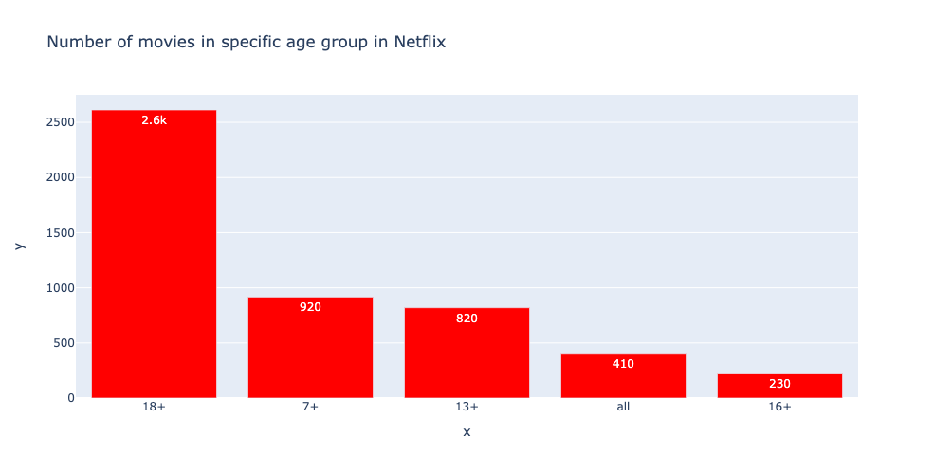
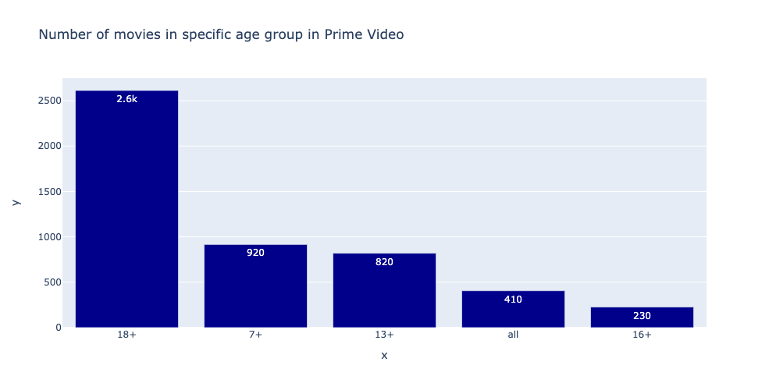
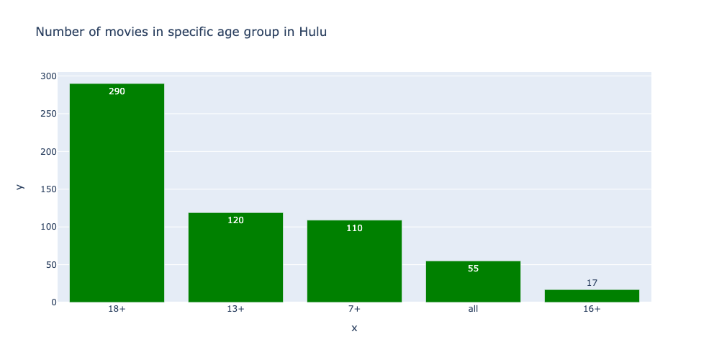
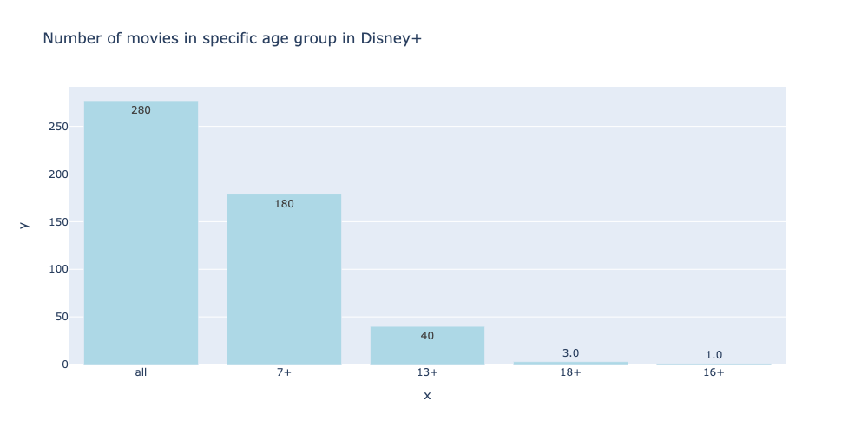
Comparing Netflix movies for specific age ranges

Slide 5
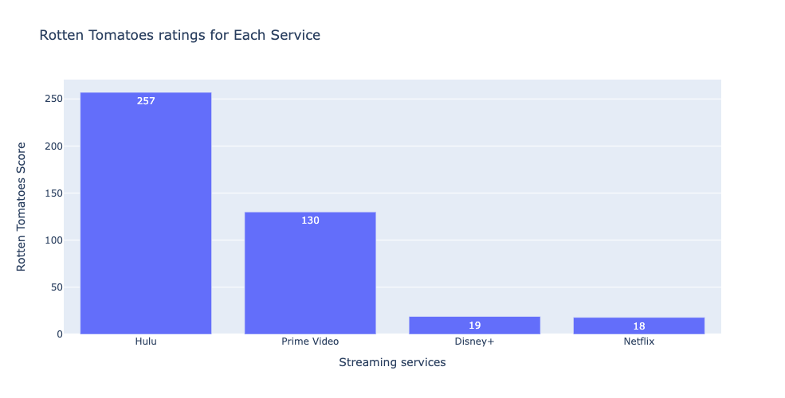
Comparing Netflix by Rotten Tomatoes

Slide 6
Recommendation/Future Work
Surveys
Which movies/ shows to add
What kind of movies should the company work on
Should there be more animes with full season
Bringing back old popular movies/shows
Better subscription plans

